Slide 1

使用 Office 365 建立生產力應用程式
Alan.Liu
Notes:
DEMOS: https://github.com/Microsoft/InsiderDevTour18-Office

Slide 2
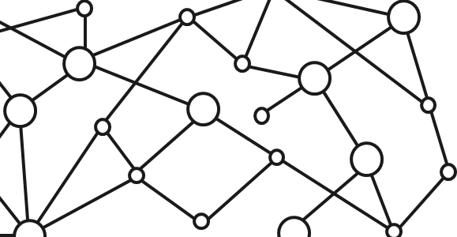
Microsoft 365 Platform
Extend Microsoft 365 experiences
web, device, and service apps
Build your experience
Documents
Pages
Conversations
Timeline
iOS/Android/Windows/Web
1
Microsoft Graph
Notes:
But wait there’s more: You can even extend it, through a wide variety of canvases and experiences – M365 is a platform

Slide 3
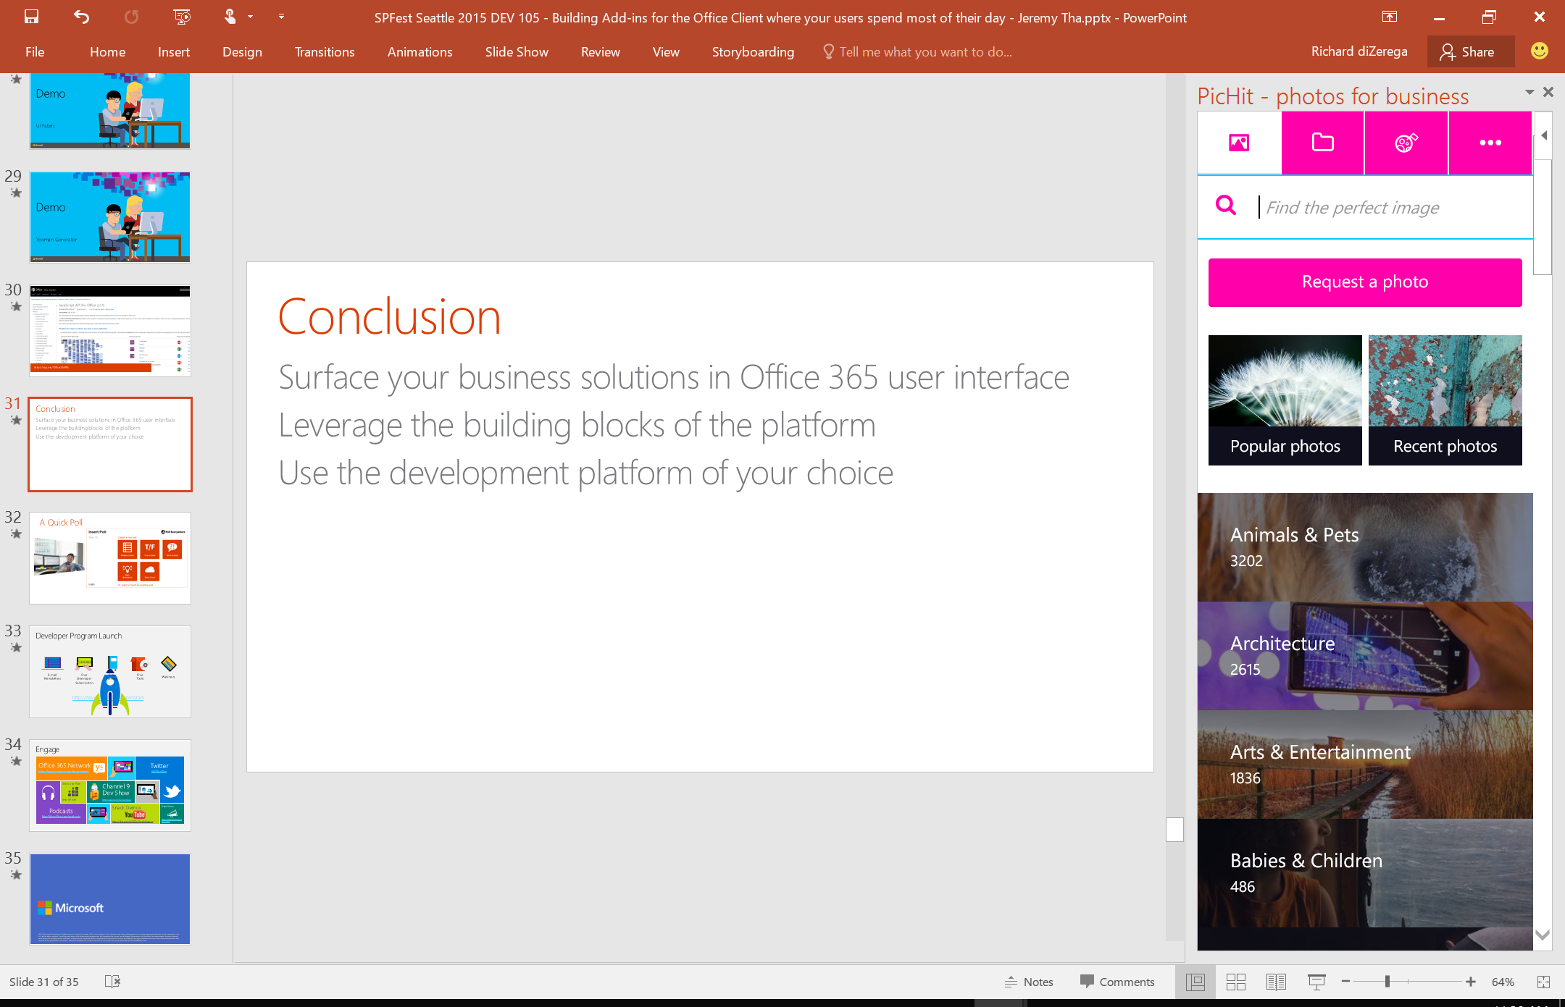
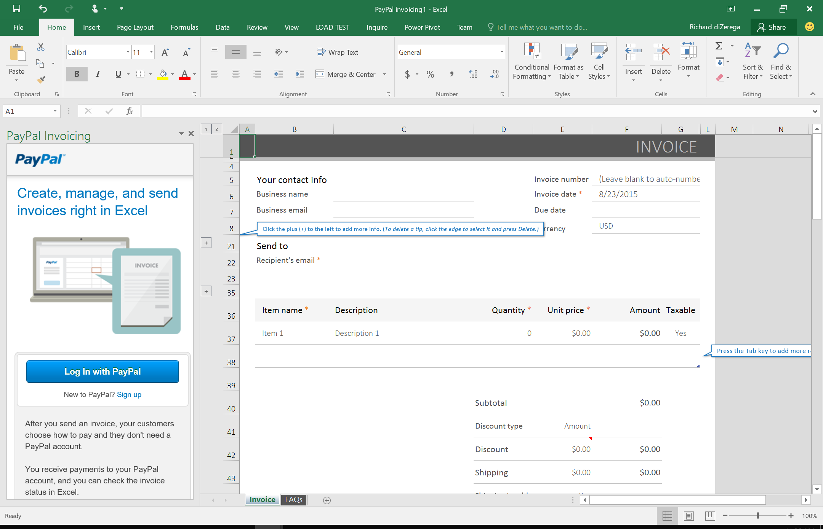
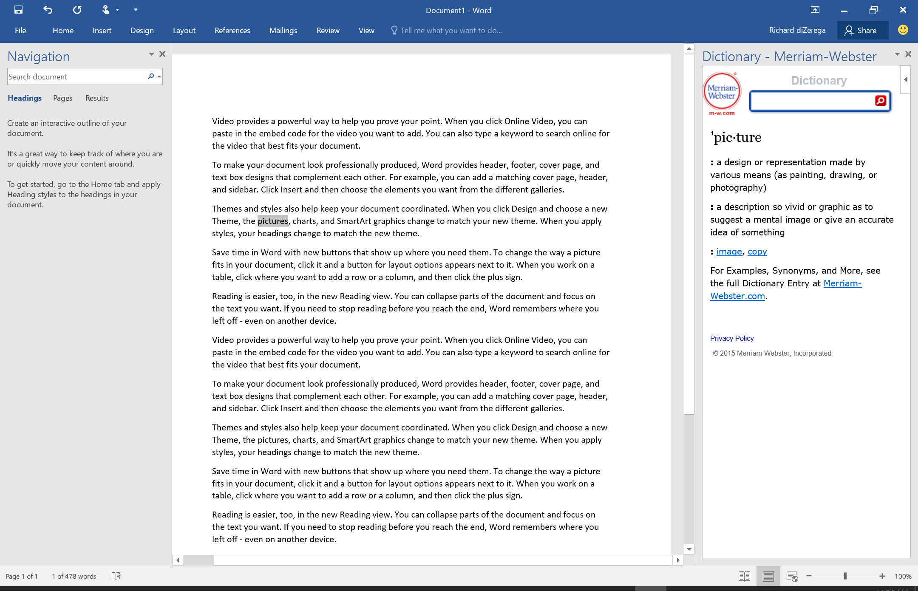
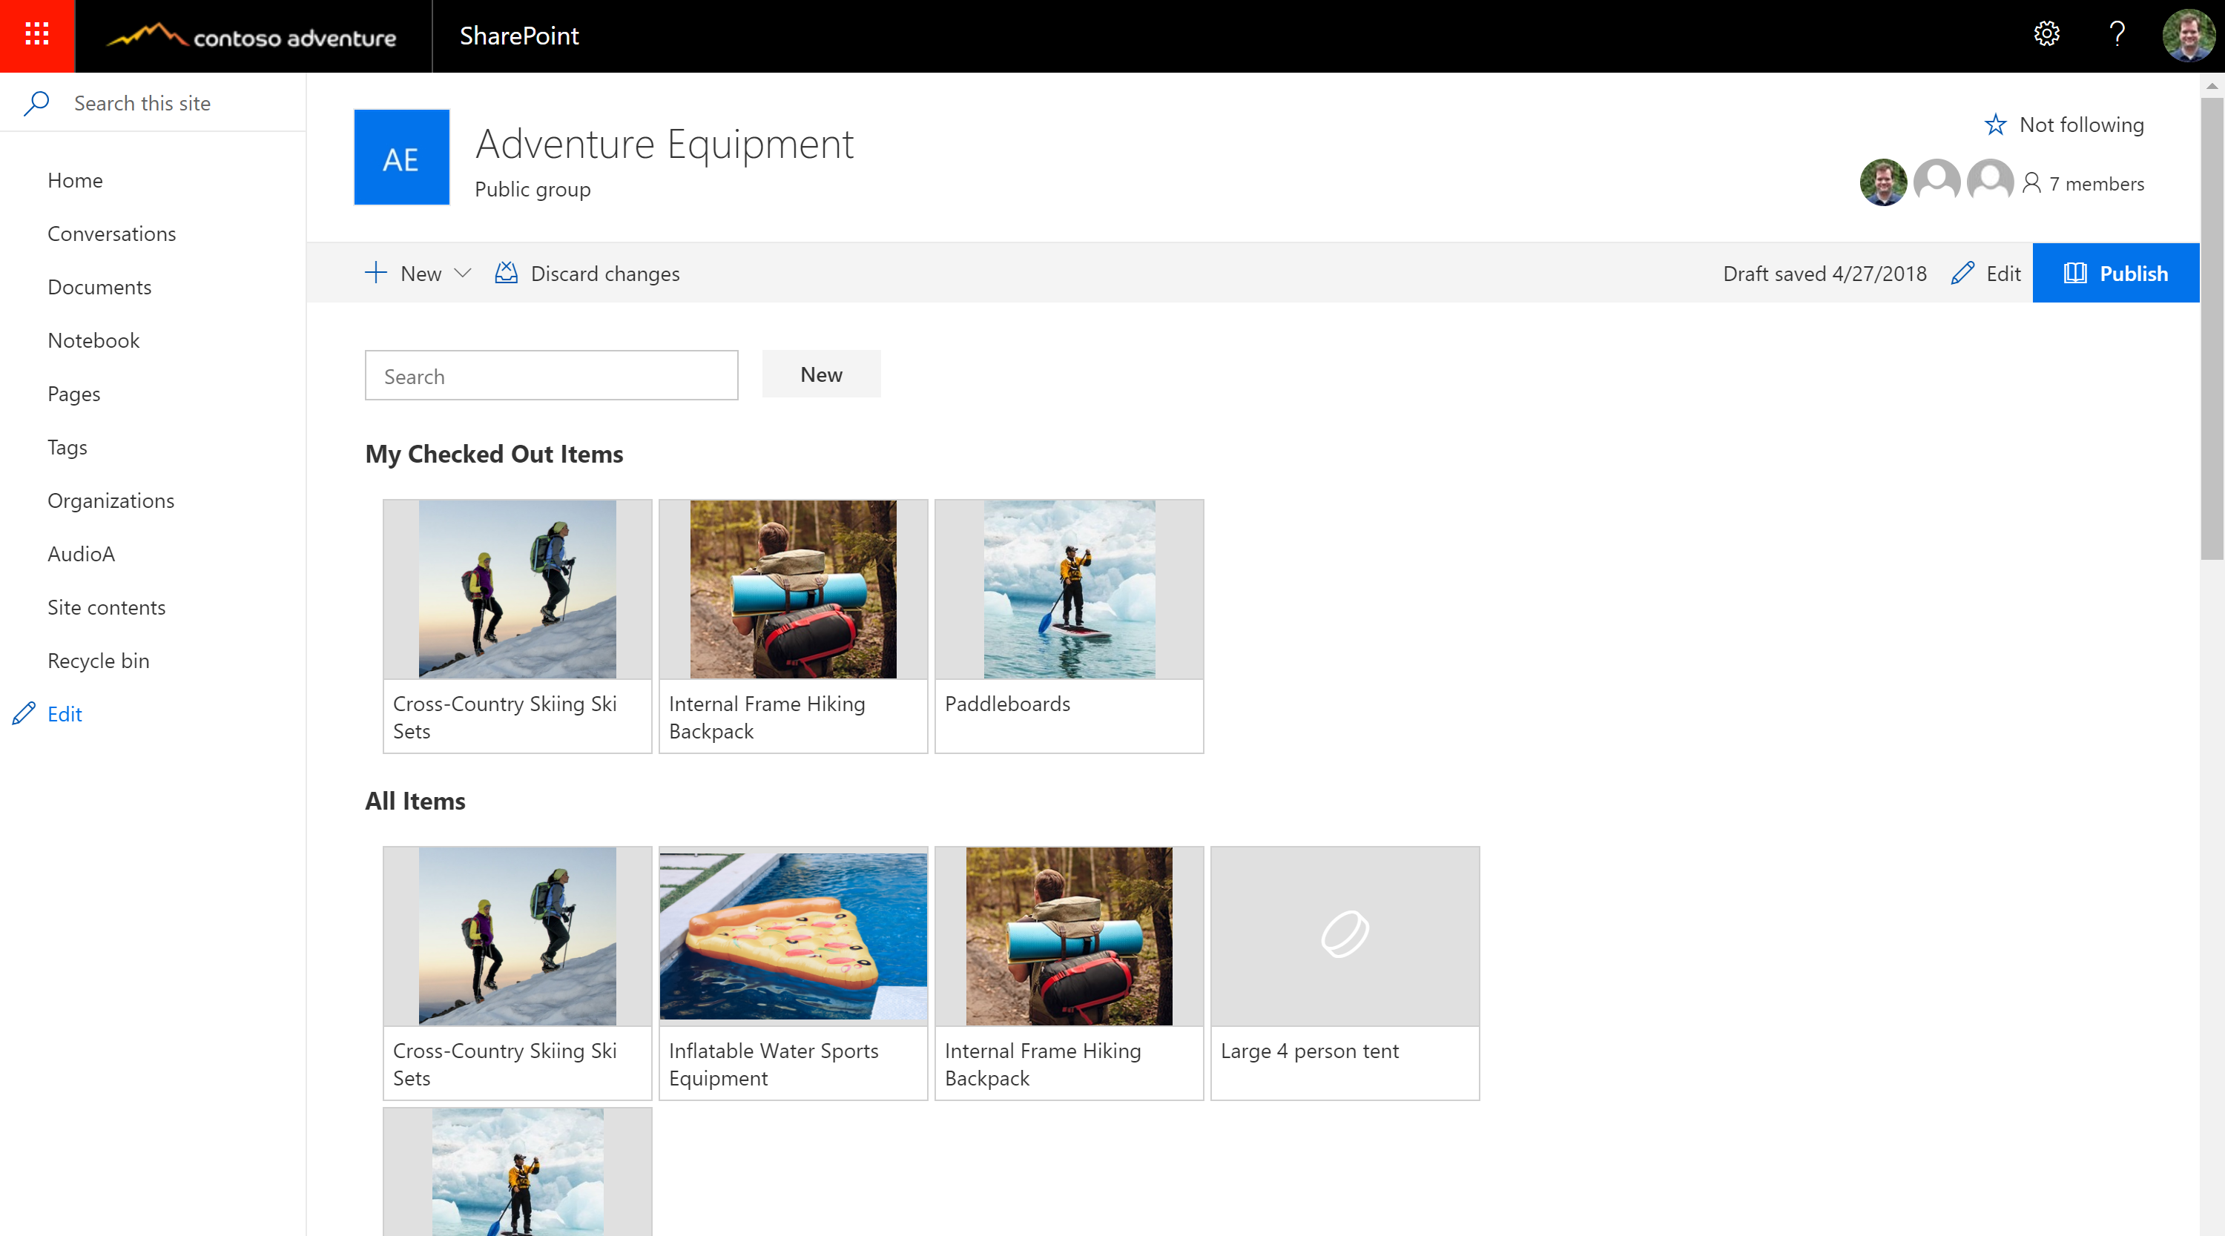
Extensions in Office

Slide 4







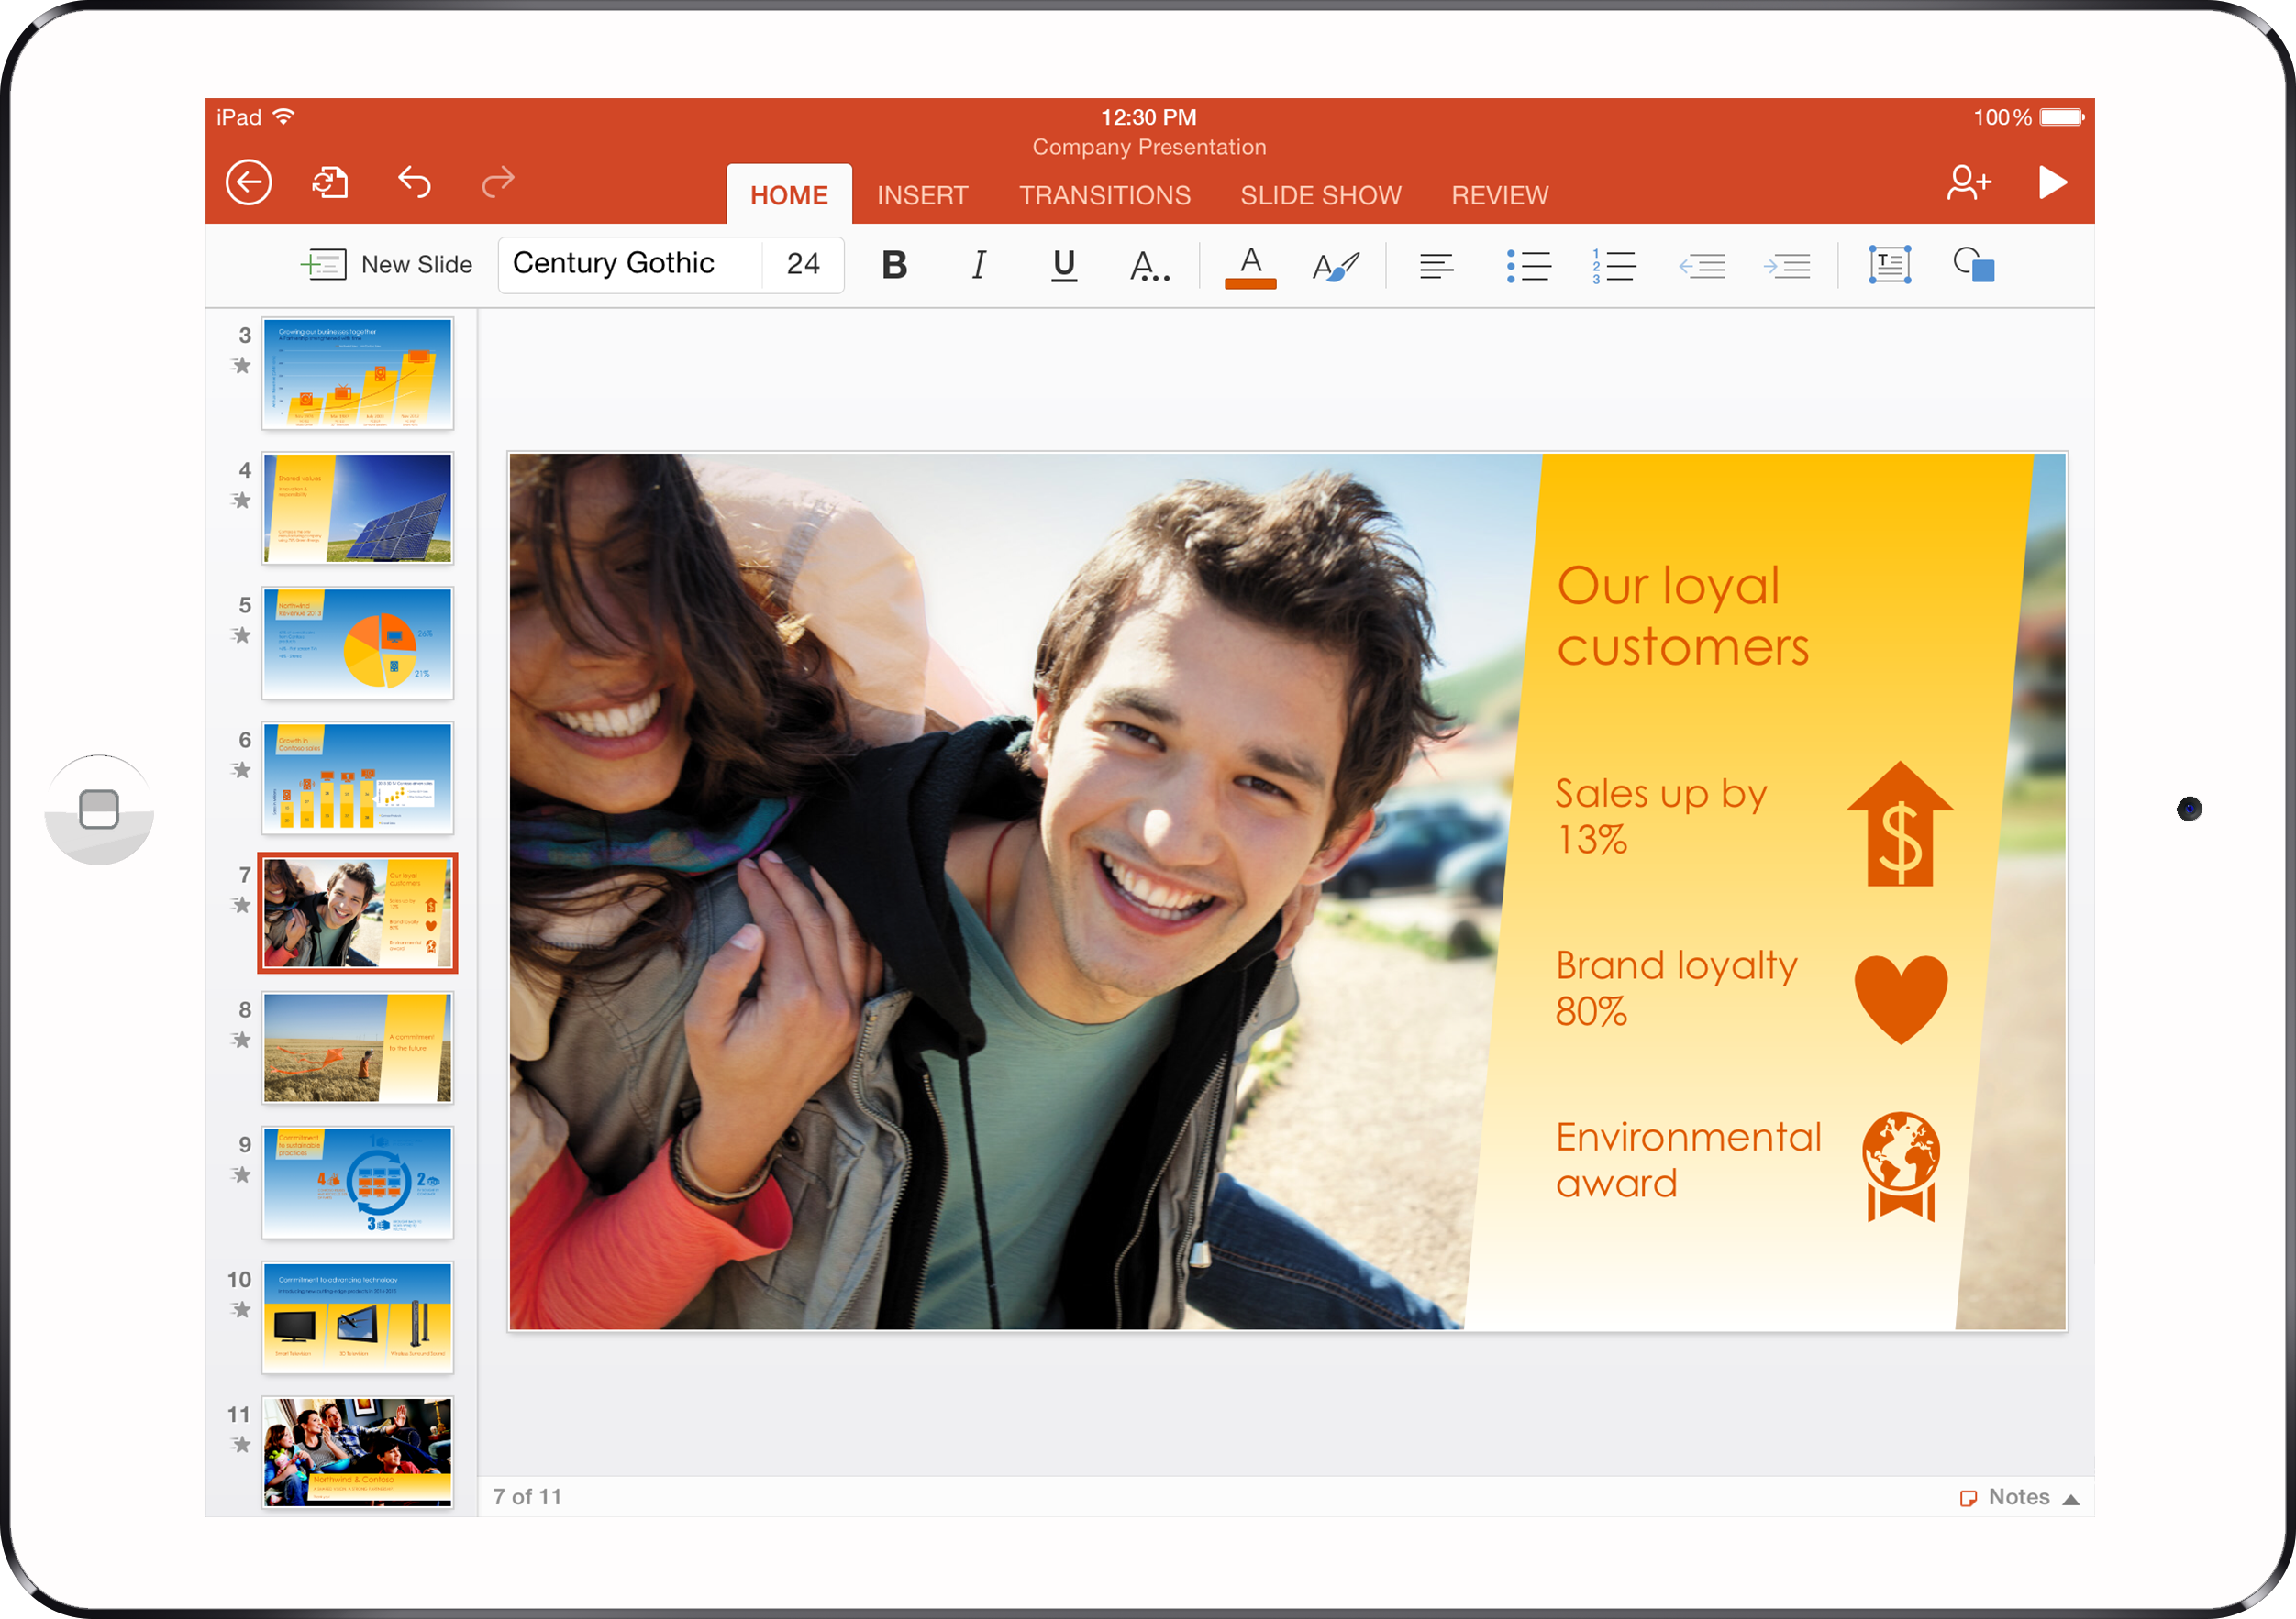

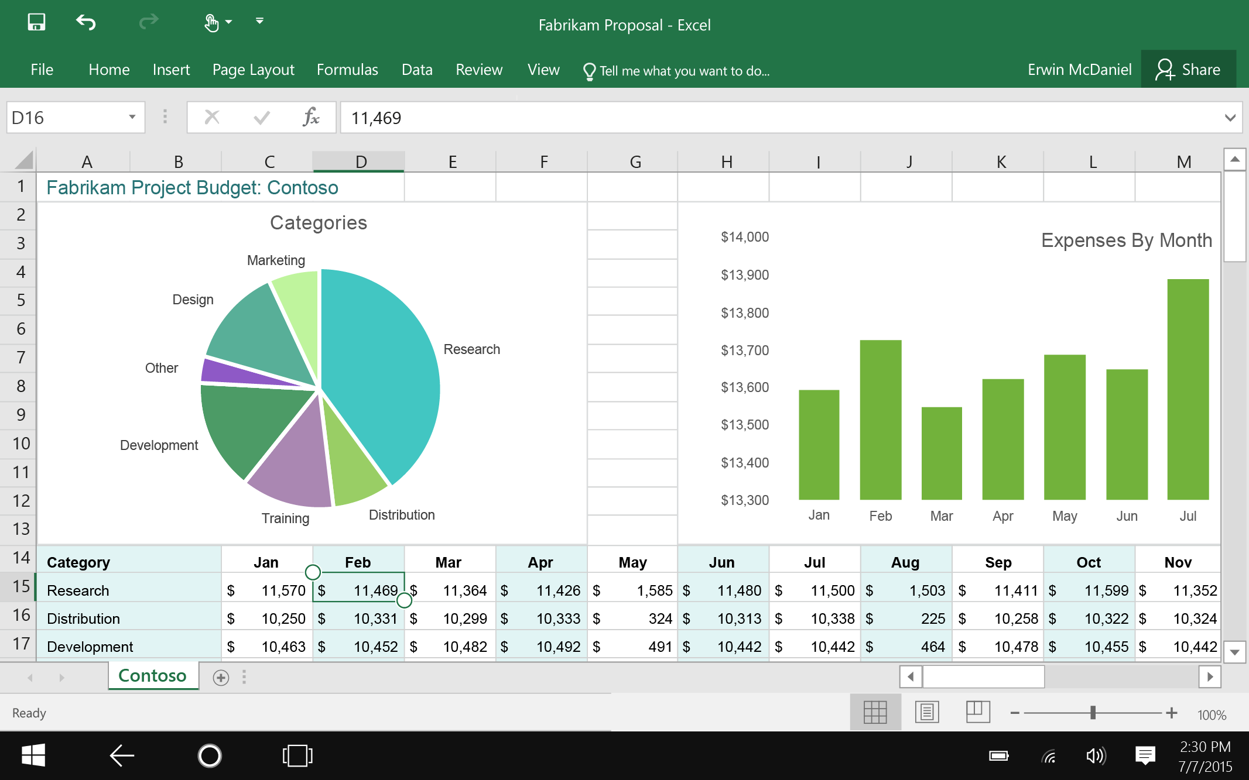
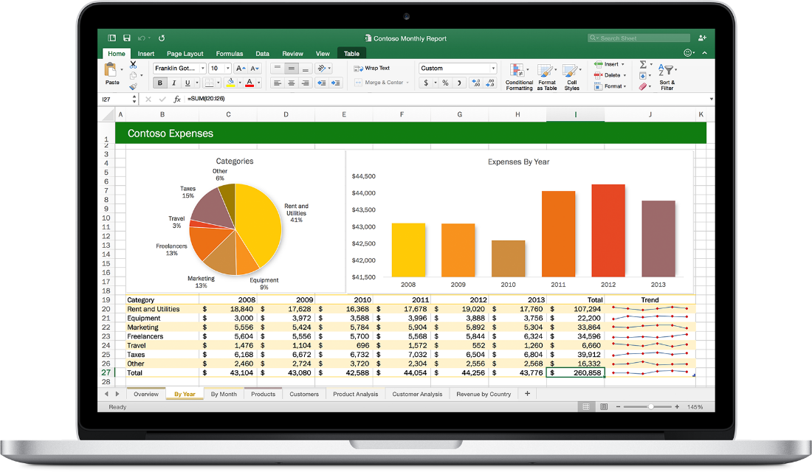


Web technologies
Make your solution part of Office canvases
Cross
platform
Extend Office applications across platforms using web technologies
Modern distribution
Store
Centralized Deployment
Notes:
利用網路傳輸技術
實現跨平台與現代化的Office

Slide 5
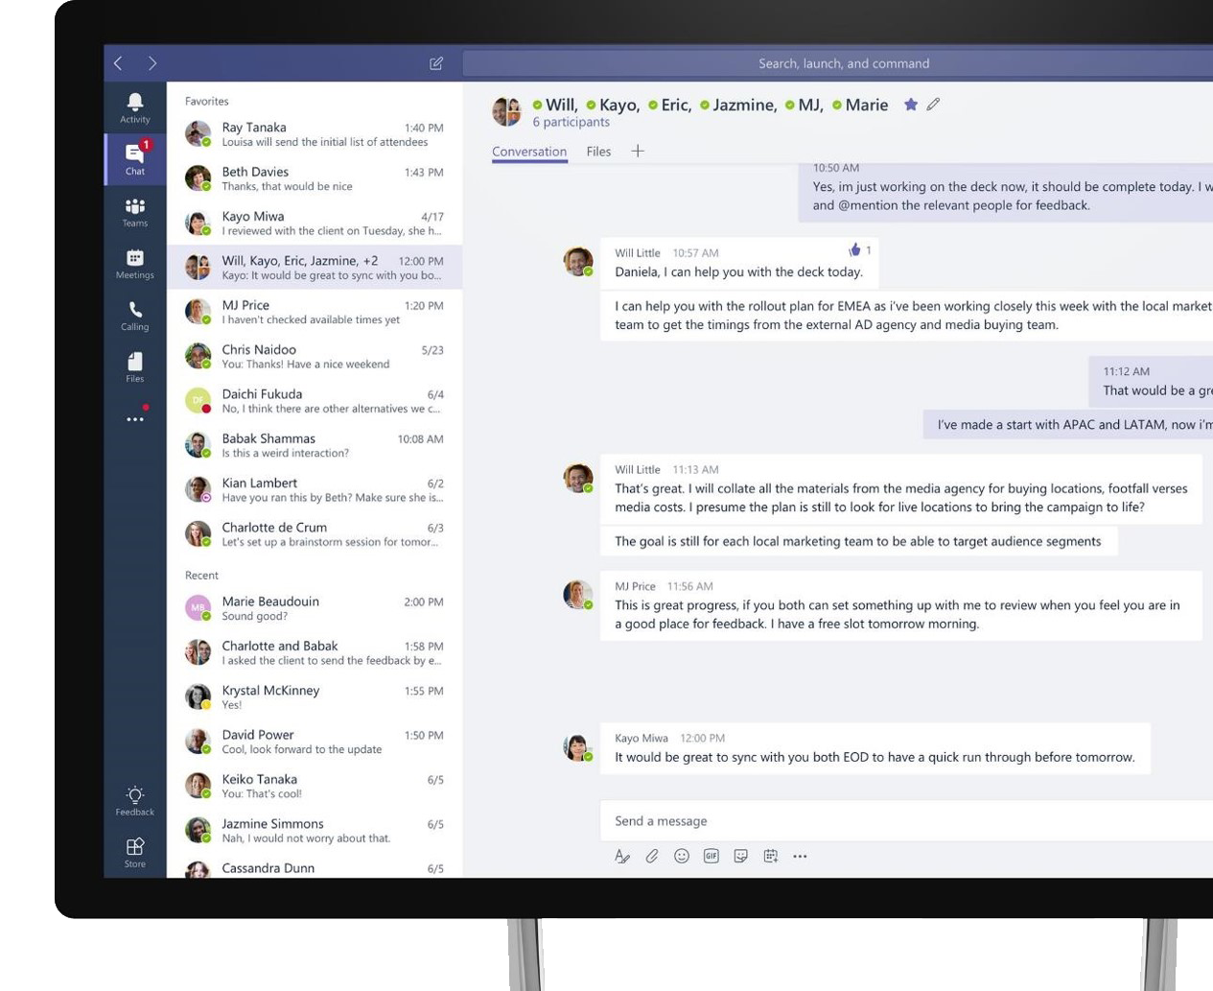
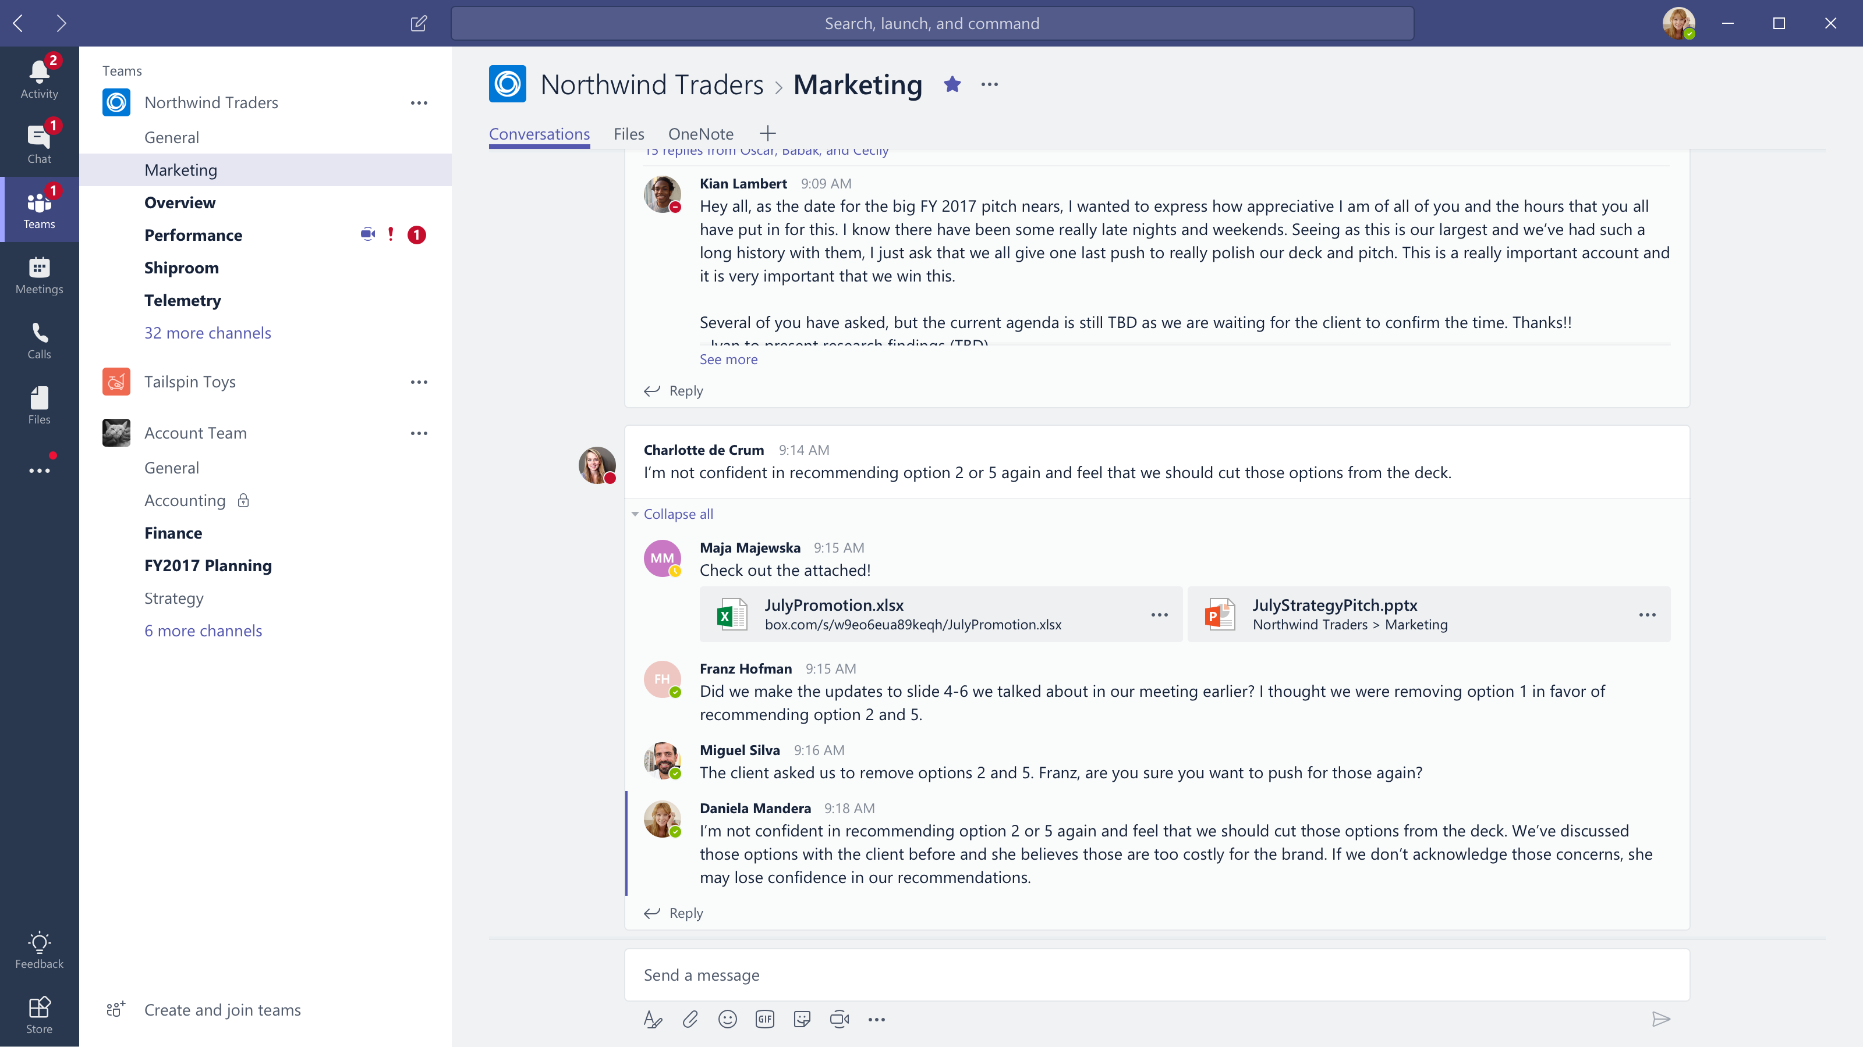



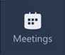


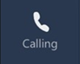

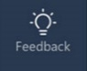

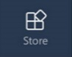
Microsoft Teams
The hub for teamwork in Office 365
Communicate
through chat, meetings & calls
Collaborate
with deeply integrated Office 365 apps
Customize & extend
with 3rd party apps, processes, and devices
Work with confidence
enterprise level security, compliance, and manageability
Notes:
1.對話、會議、在線協作令團隊溝通更加順暢
2.更有效的進行團隊合作
3.能夠利用第三方插件進行自訂義及擴展
4.企業級安全性與何規性,管理性

Slide 6
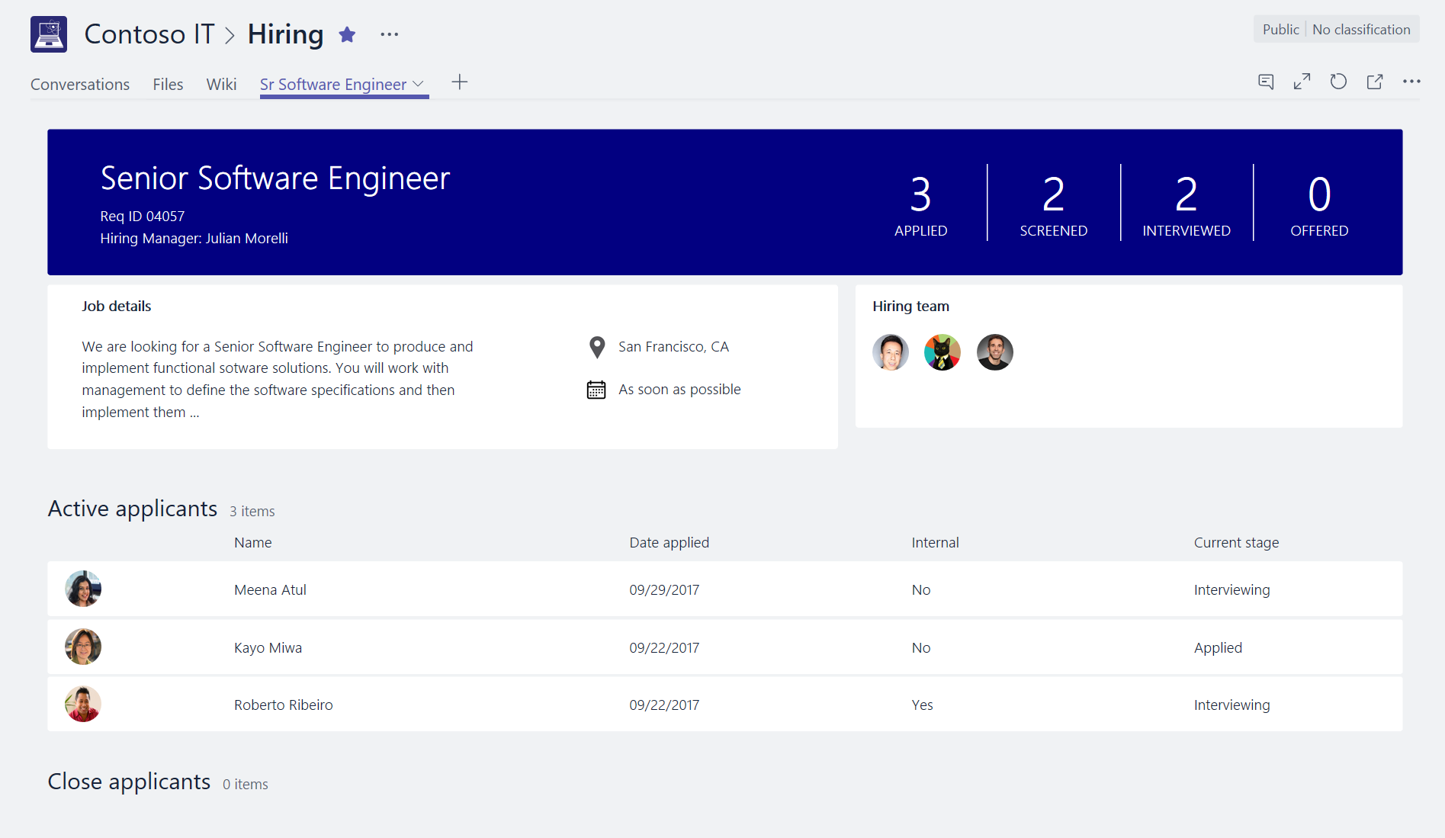
Start with a tab for collaboration
Host your app’s experience directly within Teams
As simple as embedding existing web app content
Integrate and get context via JavaScript SDK
Example: list of applicants to a job position
Notes:
在Teams內託管應用程序
就像部屬一個網站應用一樣簡易
透過整合JavaScript SDK
EX : Job Position

Slide 7








A quick note on tools…
.net
IIS Express
C#
MSBuild
Project Templates
scripting
Notes:
Why introduce a new Toolchain for SP?
SharePoint has moved from ASP.net to Front End Development.
Rapid Web Development.
Taking SharePoint to where the developers are.
Standardizing and managing the way developers were already customizing SharePoint (jslink, script editor webpart, script injection).
Reducing SharePoint proprietary components and the corresponding friction.
Bringing modern Web Tech to classic SharePoint Sites & Pages.
Allow customization on new SharePoint experiences

Slide 8
Build a Tab
Demo

Slide 9
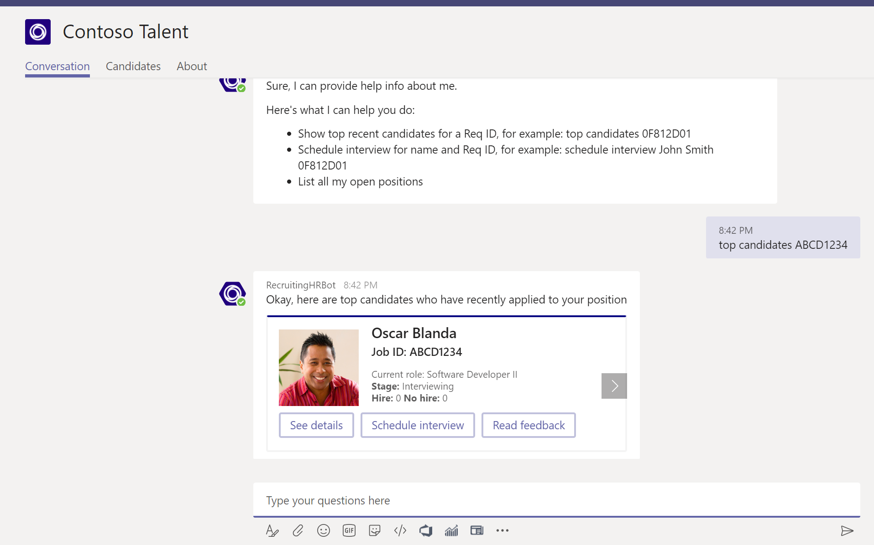
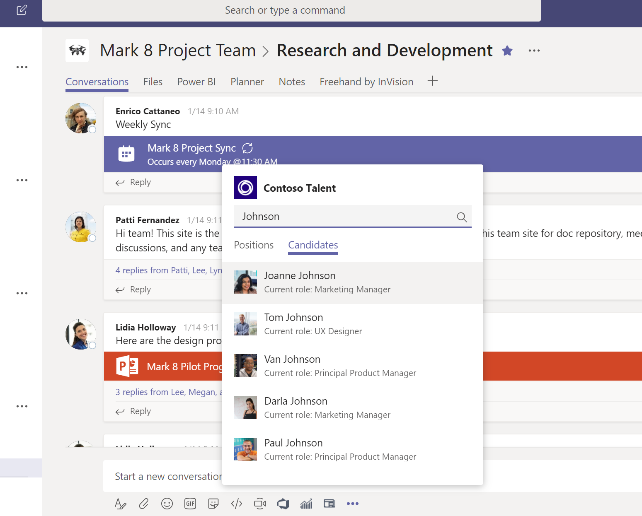
Enhance conversations with bots
Integrate with Azure Bot Services
Natural language interaction through chat bots
Structured commands through messaging extensions
New: send or receive files
New: interact with users in private chats
New: multiple structured commands
New: Bot Builder 4.0 SDK support

Slide 10
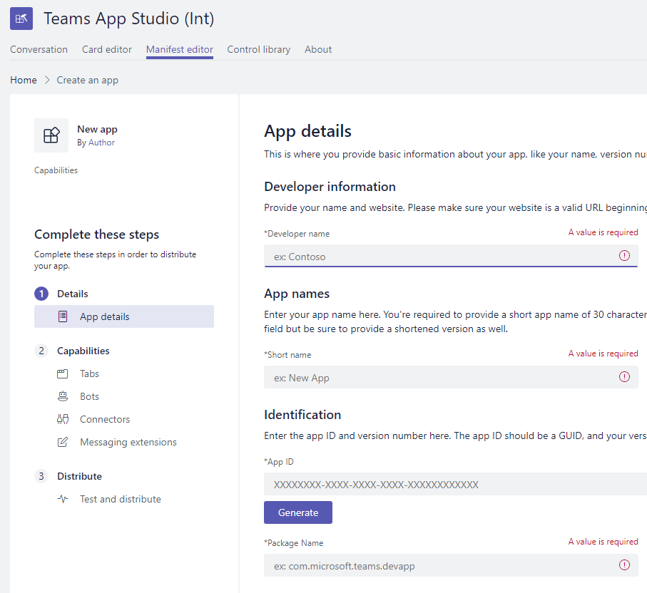
Get up and running using the Teams
App Studio
Tools to help you build your app
Define your app’s manifest through simple forms
Card visualizer and code snippet generator
Web UI control library
New: find documentation topics via chat
New: Teams App Studio saves your app manifest in the cloud
New: in-app registration with Azure Bot Service

Slide 11
Create a Bot
Demo

Slide 12









Manage distribution of Teams Apps
Capabilities
Catalog
My Apps
Admin
App Settings
App Catalog Policies
Consent
+
Install
+ Configure
+ Auth
+ Use
Team Apps
User App Policies
Manifest
Global Apps
Teams Store
(in context)
LOB
Apps
New
New

Slide 13
aka.ms/insiderdevtour-labs
Understand the Office 365 landscape
Build a Teams Tab
Build a Bot
Get started with Microsoft Graph
Notes:
Thank you! To try out some of these new features yourself, please go checkout our HANDS-ON LABS!

Slide 14
Drive User engagement Across All Your Devices with Microsoft Graph
Speaker name

